Slide 1
PTL EE Design and RVP/xEP BOM Alignment Strategy
WW43

Slide 2
PTL EE Design Requests to deliver best quality, performance and battery life, fast TTM
Common core BOM to closely match RVP/AEP for system validation quality and lower design risk. lowest power BOM/component for best battery life
Hetero IMVP PD solution (option#2) for best battery life
iPCM or Intel Power Meter during development phase for efficient power telemetry, validation and debug
PCB stack-up follow PDG/BEP to ensure memory board quality to meet POR memory speed, LPDDR5 memory layout (break-in, break-out) should follow memory clip file (818137) for memory design quality, require ODM to run iPDS, iCCT to ensure crosstalk quality
Decoupling cap selection and placement follow acoustic noise mitigation TA (#575216) to have good hardware design practices to avoid acoustic noise.
keep SFF connector for issue debug efficiency till production. keep iDV connector for power sequencing, PO debug use in EVT.
Intel team will work with Dell/ODM on each of the design requirement assessment

Slide 3
PTL EE Design and RVP/xEP BOM Alignment Strategy
While we’d like to force OEM 100% follow RVP/xEP BOM to lower design risk, several OEMs EE design are MLK/reuse chassis which BOM are reused/leveraged from MLK/previous gen which has been mass production with confidence
In order to balance the design risk and OEM BOM flexibility, propose the BOM alignment strategy to must follow and nice to follow category
Must Follow | Nice to follow
Critical to stability, battery life, performance, user experience, interoperability | Non critical to stability, battery life, performance, OEM specific features
Memory IMVP VR, hetero PD PD controller Audio DP/USB/TBT retimer/redriver PCB stackup (impact memory, HSIO) eDP panel Storage Camera Wi-Fi TPM Charger | EC BIOS flash, SPI ROM Accelerometer security module WWAN LAN (corp only, usually Intel solution)
OEM​ | LOB​ | Design name​ | Chassis​
Dell​ (CSLP) | Inspiron Plus ​ | Jarvis MLK 16” CS​ | Reuse​
HP​ (CSLP) | Omnibook 7​ | Trekker​ | Reuse​
Dell CSLP | Dell Pro Plus | Taroko (corp, non-EE) | Reuse​
Lenovo​ (CSLP) | Ideapad 5 Pro​ | S511-16P​ | Reuse​
Acer​ | Swift​ | E-Ray​ | New​
Asus​ | Zenbook S14​ | UX5406​ | Reuse​
Samsung​ (ACE) | Galaxy Book 6 Pro 16​ | Venus6​ | New​
MSFT​ | Surface Laptop & Pro​ | Marietta (Laptop)​ | Reuse​
 |  | Woodhaven (Pro)​
MSI​ | Prestige​ | tbd​ | New​
6 out of 9 PTL EE designs are reuse chassis, assume some/many key components may re-used from previous gen, need deep dive BOM review session with OEM/ODM

Slide 4
PTL EE Design and RVP/xEP BOM Risk Level and Action Plan
Lowest Risk
100% follow RVP/xEP BOM and design include “must follow” and “nice to follow” items
Customer BOM Follow RVP/xEP “Must Follow” BOM.
Not Follow RVP/xEP “Must Follow” BOM on RVP/xEP but BOM already mass production or validated in previous gen
Force customer to follow RVP/xEP “Must follow” BOM. If customer cannot change, Need alignment on validation plan to ensure low risk
Customer BOM not using RVP/xEP “Must Follow” BOM and were not validated or mass production in previous gen
Force customer to follow RVP/xEP “Must follow” BOM
High Risk

Slide 5
PTL EE Design and RVP/xEP BOM Alignment Strategy
 | RVP, BEP, AEP | Must Follow | Stability Sensitive | Battery Life Sensitive | Interoperability, User Experience sensitive
SOC | Replaceable
DRAM | LPCAMM(LP5x), MD(LP5x), SODIMM(DDR5) | V | V
VR Controller | Richtek RT3645BEN-01A MPS MP29011GQKT(BEP) | V | V | V
EC | Microchip MEC1723 eSPI (RVP, AEP) ITE IT82002VG (BEP)
LAN IC | Jacksonville
WLAN/BT | Whalepeak-2 (2x2) | V | V | V | V
Audio Codec | Realtek ALC712-VB, ALC1320 , ALC722(RVP) Cirrus Logic CS35L56(AEP) Cirrus Logic CS42L43(BEP MIPI/I2S) | V | V | V | V
Audio Amplify | N/A , within codec (RVP) CLASS_D_AMP,NA,CS35L63 (BEP) | V | V | V | V
BIOS Flash | Macronix 64MB GigaDevice GD25LB512MEYIGR 64MB (BEP)
DP Redriver DP Retimer | no DP redriver/retimer PS8419(retimer , for HDMI) PS8219(redriver, for HDMI) | V | V | V | V
Discrete TBT | Barlow Ridge | V | V | V | V
TBT Retimer | HBR(RVP, AEP) , GBR (BEP) | V | V | V | V
PD Controller | CYPD6229(RVP) ; TPS66994 (AEP); RTS5453P-28(RVP) GBR(BEP) | V | V | V | V
USB3.2 Gen2 Retimer | Doides PI3EQX1004E2ZTFEX (BEP)
USB3 Retimer USB3 Redriver | Diodes PI3EQX1002E redriver (RVP)
USB2 Redriver | TUSB212IRWBR(AEP , BEP-reserved)
Discrete TPM | Infineon SLB9672VQ 2.0 (RVP, AEP, BEP) Nations Tech Z32H330TC(RVP) | V |  | V
Card Reader IC | BayHub BH770GG7(AEP)
eDP Panel | Follow 3PE team recommendation for best battery life | V |  | V | V
PCB | T3 or T4, 6L or 8L or 10 L | V | V
Storage | Gen4 NVMe WD SN810 CS-512GB | V |  | V
Charger | RAA489110ARGNP(RVP, AEP) SC8885SQDER(BEP) | V |  | V

Slide 6
PTL EE/CSLP BOM Alignment Status
#​ | OEM​ | LOB​ | Design name​ | Chassis​ | Gerber out | Power on | BOM Alignment Status
1​ | Dell​ (CSLP) | Inspiron Plus ​ | Jarvis MLK 16” CS​ | Reuse​ | WW42.2 | WW42 ES0 | Meeting plan WW43.4
2​ | HP​ (CSLP) | Omnibook 7​ | Trekker​ | Reuse​ | WW46 | WW50 | Meeting plan WW44.3
 | Dell CSLP | Dell Pro Plus | Taroko (corp, non-EE) | Reuse​ | Pending | Q1’25 | First meeting on WW43.1 Follow up meeting on WW43.5
3​ | Lenovo​ (CSLP) | Ideapad 5 Pro​ | S511-16P​ | Reuse​ |  | WW42 ES0
4​ | Acer​ | Swift​ | E-Ray​ | New​ |  | WW48
5​ | Asus​ | Zenbook S14​ | UX5406​ | Reuse​ |  | WW48
6​ | Samsung​ (ACE) | Galaxy Book 6 Pro 16​ | Venus6​ | New​ |  | WW51
7​ | MSFT​ | Surface Laptop & Pro​ | Marietta (Laptop)​ | Reuse​ |  | WW48
 |  |  | Woodhaven (Pro)​
8​ | MSI​ | Prestige​ | tbd​ | New​ |  | WW48

Slide 7
PTL Designs BOM
 |  | RVP, BEP, AEP | Dell Cons. CSLP Jarvis-PTL | Dell Corp. CSLP Taroko-PTL | HP Trekker
SOC |  | Replaceable | PTL H 12Xe | PTL H 404 | PTL H 12Xe
DRAM |  | LPCAMM(LP5x), MD(LP5x), SODIMM(DDR5) | LPDDR5/x | DDR5 SODIMM 1DPC | LPDDR5/x
VR Controller | Terry | Richtek RT3645BEN-01A MPS MP29011GQKT(BEP) | MPS MP29011 (code-sign with RTQ3700FH) | MPS MP29011 | Richtek RT3700
EC | Ethan Hsu | Microchip MEC1723 eSPI (RVP, AEP) ITE IT82002VG (BEP) | NUVOTON NPCX497XA0BX | Microchip MEC5407 | ITE IT51366VG-512/CW
MCU |  | N/A | N/A | NA | N/A
SIO |  | N/A | N/A | NA | N/A
LAN IC |  | Jacksonville | N/A | Intel WGI219LM-SLKJ2-A0 | N/A
WLAN/BT | Jonathan, Ethan | Whalepeak-2 (2x2) | Intel M.2 2230 BE201/BE211 | CNVI/PCIe | Intel AX211
Audio Codec | Ivan, Vincent | Realtek ALC712-VB, ALC1320 , ALC722(RVP) Cirrus Logic CS35L56(AEP) Cirrus Logic CS42L43(BEP MIPI/I2S) | REALTEK ALC3329 | Planned use Cirrus CS42L45 | Realtek ALC3315-CG
Audio Amplify | Ivan, Vincent | N/A , within codec (RVP) CLASS_D_AMP,NA,CS35L63 (BEP) | N/A | Planned use Cirrus CS35L63 | Cirrus Logic CS35L51A-CWZR
BIOS Flash |  | Macronix 64MB GigaDevice GD25LB512MEYIGR 64MB (BEP) | 32MB+16MB | Winbond W25R512NWEIQ | 32MB
DDS Switch |  | N/A | N/A | NA | N/A
HDMI Pcon |  | N/A | N/A | NA | N/A
DP Redriver DP Retimer | Ethan help power Antonio check with Lyndon | no DP redriver/retimer PS8419(retimer , for HDMI) PS8219(redriver, for HDMI) | PARADE PS8210 | NA | ANX7494 (HDMI re-driver)
PCIE Redriver PCIE Retimer |  | N/A | N/A | NA | N/A
Discrete TBT |  | Barlow Ridge | N/A | NA | N/A
TBT Retimer |  | HBR(RVP, AEP) , GBR (BEP) | Intel Hayden Bridge JHL9040R | HBR | Intel Hayden Bridge
PD Controller | Kent | CYPD6229(RVP) ; TPS66994 (AEP); RTS5453P-28(RVP) GBR(BEP) | Cypress CYPD6229 | TI TPS66994E | Realtek RTS5458P
USB3.2 Gen2 Retimer |  | Doides PI3EQX1004E2ZTFEX (BEP) | N/A | NA | TI TUSB1002ARGER
USB3 Retimer USB3 Redriver | Ethan Hsu to help | Diodes PI3EQX1002E redriver (RVP) | TI TUSB522 | TI TUSB522PIRGER | TUSB522PRGER (5G re-driver) TUSB1002ARGER (10G re-driver)
USB2 Redriver |  | TUSB212IRWBR(AEP , BEP-reserved) | N/A | TUSB212IRWBR(reserved) | N/A
Discrete TPM | Ethan Hsu to help comment | Infineon SLB9672VQ 2.0 (RVP, AEP, BEP) Nations Tech Z32H330TC(RVP) | Nuvoton NPCT760JABYX | STMicro ST33HTPH2X32AHE4 | NPCT760HABYX
Card Reader IC |  | BayHub BH770GG7(AEP) | N/A | NA | N/A
eDP Panel | CY Liang, Alfred |  | FHD / QHD / OLED QHD | Non-TCON+ on LW panels
PCB | HW team | T3 or T4, 6L or 8L or 10 L | Type-3, 10L, Mid-loss EM370 equivalent material | T3 10L | T3/10L
Storage | Ethan Hsu recommend Gen4 | Gen4 NVMe WD SN810 CS-512GB | 2230/2280 PCIe Gen4 SSD, UI:Gen5 SSD | M.2 2280 SSD | M.2 2280 SSD
Charger | Terry | RAA489110ARGNP(RVP, AEP) SC8885SQDER(BEP) | TI BQ25728RSNR (buck-boost) | RENESAS ISL9538CHRTZ-T | TI BQ25728

Slide 8
PTL Designs BOM – Jarvis vs Taroko comparison
 |  | RVP, BEP, AEP | Dell Cons. CSLP Jarvis-PTL | Dell Corp. CSLP Taroko-PTL | Risk assessment and recommendation
SOC |  | Replaceable | PTL H 12Xe | PTL H 404
DRAM |  | LPCAMM(LP5x), MD(LP5x), SODIMM(DDR5) | LPDDR5/x | DDR5 SODIMM 1DPC
VR Controller | Terry | Richtek RT3645BEN-01A MPS MP29011GQKT(BEP) | MPS MP29011 (code-sign with RTQ3700FH) | MPS MP29011 | Jarvis/Taroko the same, low risk
EC | Ethan Hsu | Microchip MEC1723 eSPI (RVP, AEP) ITE IT82002VG (BEP) | NUVOTON NPCX497XA0BX | Microchip MEC5407 | Need to check EC power
MCU |  | N/A | N/A | NA
SIO |  | N/A | N/A | NA
LAN IC |  | Jacksonville | N/A | Intel WGI219LM-SLKJ2-A0 | Only corp design has WLAN
WLAN/BT | Jonathan, Ethan | Whalepeak-2 (2x2) | Intel M.2 2230 BE201/BE211 | CNVI/PCIe
Audio Codec | Ivan, Vincent | Realtek ALC712-VB, ALC1320 , ALC722(RVP) Cirrus Logic CS35L56(AEP) Cirrus Logic CS42L43(BEP MIPI/I2S) | REALTEK ALC3329 | Planned use Cirrus CS42L45 | CS42L45 sample is Jan'25 and it is new codec which we haven't enabled, will need to work with Cirrus to bring up, Dell need to know the risk here
Audio Amplify | Ivan, Vincent | N/A , within codec (RVP) CLASS_D_AMP,NA,CS35L63 (BEP) | N/A | Planned use Cirrus CS35L63 | CS35L63 is new smart amp but most efforts can be leveraged from existing smart amp.
BIOS Flash |  | Macronix 64MB GigaDevice GD25LB512MEYIGR 64MB (BEP) | 32MB+16MB | Winbond W25R512NWEIQ
DDS Switch |  | N/A | N/A | NA
HDMI Pcon |  | N/A | N/A | NA
DP Redriver DP Retimer | Ethan help power Antonio check with Lyndon | no DP redriver/retimer PS8419(retimer , for HDMI) PS8219(redriver, for HDMI) | PARADE PS8210 | Parade PS8210 | PS8210 (HDMI 2.0 redriver) have impleent in pre-gen Dell designs, which is pin-to-pin with PS8219 (HDMI2.1 redriver) and PS8419 (HDMI2.1 retimer). Need to check PS8210 vs 8419/8219 difference from function, power perspective.
Discrete TBT |  | Barlow Ridge | N/A | NA
TBT Retimer |  | HBR(RVP, AEP) , GBR (BEP) | Intel Hayden Bridge JHL9040R | HBR | Jarvis/Taroko the same, low risk
PD Controller | Kent | CYPD6229(RVP) ; TPS66994 (AEP); RTS5453P-28(RVP) GBR(BEP) | Cypress CYPD6229 | TI TPS66994E | Taroko, Jarvis no the same but Taroko part used on AEP, low risk
USB3.2 Gen2 Retimer |  | Doides PI3EQX1004E2ZTFEX (BEP) | N/A | NA
USB3 Retimer USB3 Redriver | Ethan Hsu to help | Diodes PI3EQX1002E redriver (RVP) | TI TUSB522 | TI TUSB522PIRGER | Javis/Taroko the same but not the same as RVP, need to asses.
USB2 Redriver |  | TUSB212IRWBR(AEP , BEP-reserved) | N/A | TUSB212IRWBR(reserved) | Same xEP, assume low risk
Discrete TPM | Ethan Hsu to help comment | Infineon SLB9672VQ 2.0 (RVP, AEP, BEP) Nations Tech Z32H330TC(RVP) | Nuvoton NPCT760JABYX | STMicro ST33HTPH2X32AHE4
Card Reader IC |  | BayHub BH770GG7(AEP) | N/A | NA
eDP Panel | CY Liang, Alfred |  | FHD / QHD / OLED QHD | Non-TCON+ on LW panels
PCB | HW team | T3 or T4, 6L or 8L or 10 L | Type-3, 10L, Premium Mid-loss EM390 equivalent material | T3 10L
Storage | Ethan Hsu recommend Gen4 | Gen4 NVMe WD SN810 CS-512GB | 2230/2280 PCIe Gen4 SSD, UI:Gen5 SSD | M.2 2280 SSD
Charger | Terry | RAA489110ARGNP(RVP, AEP) SC8885SQDER(BEP) | TI BQ25728RSNR (buck-boost) | RENESAS ISL9538CHRTZ-T | Not the same as Jarvis, also not the same as RVP/xEP

Slide 9
PTL Designs BOM - Jarvis
 |  | RVP, BEP, AEP | Dell Cons. CSLP Jarvis-PTL | Risk Assessment & Recommendation
SOC |  | Replaceable | PTL H 12Xe
DRAM |  | LPCAMM(LP5x), MD(LP5x), SODIMM(DDR5) | LPDDR5/x | Customer can refer to ARL-HU memory enabling guide#790156, which support LPDDR5/x T3 1R/2R 7467 enabled list. Need Dell provide the LP5 part list.
VR Controller | Terry | Richtek RT3645BEN-01A MPS MP29011GQKT(BEP) | MPS MP29011 (code-sign with RTQ3700FH) | Same as BEP, low risk
EC | Ethan Hsu | Microchip MEC1723 eSPI (RVP, AEP) ITE IT82002VG (BEP) | NUVOTON NPCX497XA0BX | Need to check power consumption
MCU |  | N/A | N/A
SIO |  | N/A | N/A
LAN IC |  | Jacksonville | N/A
WLAN/BT | Jonathan, Ethan | Whalepeak-2 (2x2) | Wi-Fi 6 Intel AX211 (Garfield Peak 2) Wi-Fi 7 R2 Intel BE211 (Whale Peak 2) | Same as RVP/xEP, low risk
Audio Codec | Ivan, Vincent | Realtek ALC712-VB, ALC1320 , ALC722(RVP) Cirrus Logic CS35L56(AEP) Cirrus Logic CS42L43(BEP MIPI/I2S) | REALTEK ALC3329 | ALC3329 (=ALC722) same as RVP, low risk
Audio Amplify | Ivan, Vincent | N/A , within codec (RVP) CLASS_D_AMP,NA,CS35L63 (BEP) | N/A | No risk
BIOS Flash |  | Macronix 64MB GigaDevice GD25LB512MEYIGR 64MB (BEP) | 32MB+16MB
DDS Switch |  | N/A | N/A
HDMI Pcon |  | N/A | N/A
DP Redriver DP Retimer | Ethan help power Antonio check with Lyndon | no DP redriver/retimer PS8419(retimer , for HDMI) PS8219(redriver, for HDMI) | PARADE PS8210 | PS8210 (HDMI 2.0 redriver) have impleent in pre-gen Dell designs, which is pin-to-pin with PS8219 (HDMI2.1 redriver) and PS8419 (HDMI2.1 retimer). Need to check PS8210 vs 8419/8219 difference from function, power perspective. Need to get PS8210/PS8219 datasheet and power comparison table
PCIE Redriver PCIE Retimer |  | N/A | N/A
Discrete TBT |  | Barlow Ridge | N/A
TBT Retimer |  | HBR(RVP, AEP) , GBR (BEP) | Intel Hayden Bridge JHL9040R | Same as RVP/AEP, low risk
PD Controller | Kent | CYPD6229(RVP) ; TPS66994 (AEP); RTS5453P-28(RVP) GBR(BEP) | Cypress CYPD6229 (co-design with TPS66994) | Same as RVP/AEP, low risk Need to check CYPD and TPS pin to pin?
USB3.2 Gen2 Retimer |  | Doides PI3EQX1004E2ZTFEX (BEP) | N/A
USB3 Retimer USB3 Redriver | Ethan Hsu to help | Diodes PI3EQX1002E redriver (RVP) | TI TUSB522 | Need to check TI part vs Diode part from power, function perspective. Need to get TI datasheet to compare power consumption especially unplug
USB2 Redriver |  | TUSB212IRWBR(AEP , BEP-reserved) | N/A
Discrete TPM | Ethan Hsu to help comment | Infineon SLB9672VQ 2.0 (RVP, AEP, BEP) Nations Tech Z32H330TC(RVP) | Nuvoton NPCT760JABYX | Need to check Nuvoton part power data Get datasheet
Card Reader IC |  | BayHub BH770GG7(AEP) | N/A
eDP Panel | CY Liang, Alfred |  | FHD / QHD / OLED QHD | Can Dell share panel datasheet?
PCB | HW team | T3 or T4, 6L or 8L or 10 L | Type-3, 10L, Premium Mid-loss EM390 equivalent material | Pre-EVT is low risk. Need to align EVT PCB stack-up
Storage | Ethan Hsu recommend Gen4 | Gen4 NVMe WD SN810 CS-512GB | 2230/2280 PCIe Gen4 SSD, UI:Gen5 SSD | Gen5 SSD not optimize for power, prefer Gen4. SSD P/N share by Dell
Charger | Terry | RAA489110ARGNP(RVP, AEP) SC8885SQDER(BEP) | TI BQ25728RSNR (buck-boost) | Not the same as RVP/xEP, the power consumption difference between BQ25728 and RAA489110 is not significant, low risk

Slide 10
PTL Designs BOM - Taroko
 |  | RVP, BEP, AEP | Dell Corp. CSLP Taroko-PTL | Risk Assessment & Recommendation
SOC |  | Replaceable | PTL H 404
DRAM |  | LPCAMM(LP5x), MD(LP5x), SODIMM(DDR5) | DDR5 SODIMM 1DPC | Need to get Dell DDR5 list to compare with MIO val list 10/25 H484 + LP-CAMM2 is CSLP config. Dell to follow RVP LP-CAMM2 part for 1st PO and share planned memory part to Intel earlier. Intel memory enabling guidance with valition compatibility list parts normally release around ES2/QS timeframe. MIO validation list normally is available around QS time frame.
VR Controller | Terry | Richtek RT3645BEN-01A MPS MP29011GQKT(BEP) | MPS MP29011 | Same as BEP, low risk
EC | Ethan Hsu | Microchip MEC1723 eSPI (RVP, AEP) ITE IT82002VG (BEP) | Microchip MEC5407 | Need to check EC power consumption 10/25: Dell to provide EC power consumption spec for Intel review.
MCU |  | N/A | NA
SIO |  | N/A | NA
LAN IC |  | Jacksonville | Intel WGI219LM-SLKJ2-A0
WLAN/BT | Jonathan, Ethan | Whalepeak-2 (2x2) | CNVI/PCIe
Audio Codec | Ivan, Vincent | Realtek ALC712-VB, ALC1320 , ALC722(RVP) Cirrus Logic CS35L56(AEP) Cirrus Logic CS42L43(BEP MIPI/I2S) | Planned use Cirrus CS42L45 | CS42L45 sample is Jan'25 and it is new codec which we haven't enabled, will need to work with Cirrus to bring up, Dell need to know the risk here . Can dell get AIC from Crirrus logic to bring up first 10/25 Dell feedback CSLP will use CS42L43 to minimize risk.
Audio Amplify | Ivan, Vincent | N/A , within codec (RVP) CLASS_D_AMP,NA,CS35L63 (BEP) | Planned use Cirrus CS35L63 | Same as BEP, low risk. 10/25: Under investigation by Dell. Not POR yet.
BIOS Flash |  | Macronix 64MB GigaDevice GD25LB512MEYIGR 64MB (BEP) | Winbond W25R512NWEIQ
DDS Switch |  | N/A | NA
HDMI Pcon |  | N/A | NA
DP Redriver DP Retimer | Ethan help power Antonio check with Lyndon | no DP redriver/retimer PS8419(retimer , for HDMI) PS8219(redriver, for HDMI) | Parade PS8210 | PS8210 (HDMI 2.0 redriver) have impleent in pre-gen Dell designs, which is pin-to-pin with PS8219 (HDMI2.1 redriver) and PS8419 (HDMI2.1 retimer). Need to check PS8210 vs 8419/8219 difference from function, power perspective. 10/25: Leverage Gen16, Dell feedback it’s low risk.
PCIE Redriver PCIE Retimer |  | N/A | NA
Discrete TBT |  | Barlow Ridge | NA
TBT Retimer |  | HBR(RVP, AEP) , GBR (BEP) | HBR | Same as RVP, low risk
PD Controller | Kent | CYPD6229(RVP) ; TPS66994 (AEP); RTS5453P-28(RVP) GBR(BEP) | TI TPS66994E | Same as AEP, low risk
USB3.2 Gen2 Retimer |  | Doides PI3EQX1004E2ZTFEX (BEP) | NA
USB3 Retimer USB3 Redriver | Ethan Hsu to help | Diodes PI3EQX1002E redriver (RVP) | TI TUSB522PIRGER | Need to check TI retimer power consumption 10/25: Leverage Gen16, Dell feedback it’s low risk.
USB2 Redriver |  | TUSB212IRWBR(AEP , BEP-reserved) | TUSB212IRWBR(reserved) | Same as xEP, low risk
Discrete TPM | Ethan Hsu to help comment | Infineon SLB9672VQ 2.0 (RVP, AEP, BEP) Nations Tech Z32H330TC(RVP) | STMicro ST33HTPH2X32AHE4 | Need to check TPM power consumption 10/25: Has used for many gen, Dell feedback it’s low risk
Card Reader IC |  | BayHub BH770GG7(AEP) | NA
eDP Panel | CY Liang, Alfred |  | Non-TCON+ on LW panels
PCB | HW team | T3 or T4, 6L or 8L or 10 L | Type-3, 10L, Premium Mid-loss EM390 equivalent material | Low risk, Dell consider 8L,
Storage | Ethan Hsu recommend Gen4 | Gen4 NVMe WD SN810 CS-512GB | M.2 2280 SSD | Need to check whether Gen4/5 SSD and get SSD P/N 10/25: H484 SKU is Gen5 only. Need Dell to check with vendor to provide power data and evaluate thermal solution data. H404 SKU is Gen5 controller + Gen4 SSD; power data from Tributo is ok.
Charger | Terry | RAA489110ARGNP(RVP, AEP) SC8885SQDER(BEP) | RENESAS ISL9538CHRTZ-T | Not the same as RVP,xEP, the power consumption of ISL9538 is the same as RAA489110, low risk

Slide 11
PTL Designs BOM - Bolan
 | RVP, BEP, AEP | Dell Pro Premium Bolan - PTL | Risk Assessment & Recommendation & Note
SOC | Replaceable | CPU ON-BOARD | 484/404 (no 12Xe)
DRAM | LPCAMM(LP5x), MD(LP5x), SODIMM(DDR5) | LPDDR5x MD x4 | Memory topology is the same as RVP ,low risk.
VR Controller | Richtek RT3645BEN-01A MPS MP29011GQKT(BEP) | MPS MP29011 | WW28.2: Approach#1 should be ok to design on Bolan. Intel has discussed with Compal power team to evaluate approach#2 which can improve 2-3% more efficiency, Compal is checking inductor vendor on the components. Priority is to keep same z-height, 3mm. CP WW29.2 to discuss with Terry. Target 7/28 EVT gerber out. Low risk, Hetero PD approach1 implementation, suggestion ehance to approach 2 (need larger inductor size)
EC | Microchip MEC1723 eSPI (RVP, AEP) ITE IT82002VG (BEP) | MEC5507 | WW28.2: From Dell consumer project, EC power consumption is around 10mW. Power consumption might be relevant to GPIO implementation during Mods, we need Compal to review SW implementation and to optimize it. Dell EC code owns by ADC and is leveraging from Taroko, Kevin/Jay to bring up this topic to Taroko DM Gino to check improvement opportunity. New part-the P/N hasn't been used, medium risk. Current MEC5507 consume 25mW in ModS based on LNL Bolan data. Suggest to optimize to 10mW
MCU | N/A | N/A
SIO | N/A | N/A
LAN IC | Jacksonville | N/A | Bolan confirmed no LAN.
WLAN/BT | Whalepeak-2 (2x2) | CNVio3 on board BE211 | Same as RVP. Low Risk. But please kindly submit the SCH/Layout review to the Wireless team.
Audio Codec | Realtek ALC712-VB, ALC1320 , ALC722(RVP) Cirrus Logic CS35L56(AEP) Cirrus Logic CS42L43(BEP MIPI/I2S) | Cirrus CS42L43 | Low risk. Same as BEP
Audio Amplify | N/A , within codec (RVP) CLASS_D_AMP,NA,CS35L63 (BEP) | Cirrus CS35L56A | Low risk, same as AEP
BIOS Flash | Macronix 64MB GigaDevice GD25LB512MEYIGR 64MB (BEP) | 64MB (WSON-8, 8x6mm,w/ RPMC) Windbond - W25R512NWEIQ XMC - XM25RU512CXIQT10S GD - GD25LR512MEYIGR | Winbond’s PN and GD’s P/N have been used in Bolan LNL Low risk
DDS Switch | N/A | N/A
HDMI Pcon | N/A | CONN MPN: CONN SDAN 602067-019102 19P HDMI 2.1) Parade PS8210 | Low risk, same P/N with Taroko LNL
DP Redriver DP Retimer | no DP redriver/retimer PS8419(retimer , for HDMI) PS8219(redriver, for HDMI) | Parade PS8210 | Bolan no DP.
PCIE Redriver, PCIE Retimer | N/A | N/A
HPD/Camera |  | MIPI Synaptics_SVP7500 | WW28.2: For Synaptics, we need them to disable camera power and usb-off mode during lid-closed. Also have Synaptics check if can change 3.3v to 1.8v which should be FW update. Intel is working with Dell HPD owner Nelson to have Synaptics to implement those opportunity. PTL Bolan mid board is leveraged LNL Bolan design. Jay hope to get Bolan board with wired power rails for debugging, Compal will follow up. So far Dell TDC hasn’t got 2nd source notification. Higer risk for Taroko as it’s Hero device. High risk 22mW on Synaptics SVP7500 and 6mW on camera. Need to check whether 6mW can reduce
Discrete TBT | Barlow Ridge | N/A
TBT Retimer | HBR(RVP, AEP) , GBR (BEP) | Intel Hayden Bridge(JHL9040R) | Same as AEP, low risk
PD Controller | CYPD6229(RVP) ; TPS66994 (AEP); RTS5453P-28(RVP) GBR(BEP) | TPS66994 | Same as AEP, low risk
USB3.2 Gen2 Retimer | Doides PI3EQX1004E2ZTFEX (BEP) | N/A
USB3 Retimer USB3 Redriver | Diodes PI3EQX1002E redriver (RVP) | TUSB522PIRGER | Reserve . Low risk
USB2 Redriver | TUSB212IRWBR(AEP , BEP-reserved) | TUSB212 | Reserve . Low risk
Discrete TPM | Infineon SLB9672VQ 2.0 (RVP, AEP, BEP) Nations Tech Z32H330TC(RVP) | ST Micro :ST33KTPM2X32DKJ5 support FIPS-140-3 Nuvoton :NPCT760JAD support FIPS-140-3 | New part number-the P/N hasn't been used but should be low risk.
Card Reader IC | BayHub BH770GG7(AEP) | N/A
eDP Panel |  | FHD+ LW, 400nits, 30~60Hz, Bent, eDP 1.5 (Non-Touch) FHD+ Entry, 400nits, 60Hz, Bent, eDP 1.2 (Non-Touch) QHD+, 400nits, 60Hz, Bent, eDp 1.4b, In cell Touch w/o CG NQXGA+,400nits,30~60Hz, Bent, eDp1.5, OLED w/ CG Touch | Same P/N with Bolan LNL, low risk. Need to check which SKU Dell will use to meet Hero Design.
PCB | T3 or T4, 6L or 8L or 10 L | T4/10L | WW28.2: 1st iCCT review result provided, and Intel has provided board file suggestion for the improvement, Compal will follow up for the implementation and share 2nd iCCT review result. Will work with Intel. T4 (1-8-1+) target for 8533MT/s LP5x speed (Dell/Compal/Intel will review iCCT report for memory SI)
Storage | Gen4 NVMe WD SN810 CS-512GB | M.2 SSD-Key M(2230) PCIE Gen5 | WW28.2: Bolan PTL is using Gen5 SSD connected to Gen5 PCIE port. Intel DLRM default enabled, RDC#850056. Need Dell to ensure power consumption meet spec. The first generation to use PCIe Gen5 SSD, need to check function and power consumption.
Charger | RAA489110ARGNP(RVP, AEP) SC8885SQDER(BEP) | ISL9538C | Not the same as RVP,xEP, the power consumption of ISL9538 is the same as RAA489110, low risk

Slide 12
PTL Designs BOM - Trekker
 | RVP, BEP, AEP |  | Risk Assessment & Recommendation
SOC | Replaceable | PTL - H12Xe
DRAM | LPCAMM(LP5x), MD(LP5x), SODIMM(DDR5) | LPDDR5x | Customer can refer to ARL-HU memory enabling guide#790156, which support LPDDR5/x T3 1R/2R 7467 enabled list. Need HP provide the LP5 part list.
VR Controller | Richtek RT3645BEN-01A MPS MP29011GQKT(BEP) | Richtek RT3700` | Not align with RVP/AEP
EC | Microchip MEC1723 eSPI (RVP, AEP) ITE IT82002VG (BEP) | ITE IT51366VG-512/CW | Need to check power consumption
LAN IC | Jacksonville | NA
WLAN/BT | Whalepeak-2 (2x2) | Intel Garfield Peak 2/ Fillmore Peak 2 MTK MT7925 | Not align with RVP/AEP
Audio Codec | Realtek ALC712-VB, ALC1320 , ALC722(RVP) Cirrus Logic CS35L56(AEP) Cirrus Logic CS42L43(BEP MIPI/I2S) | Realtek ALC3315-CG | ALC3315, is it HP part?
Audio Amplify | N/A , within codec (RVP) CLASS_D_AMP,NA,CS35L63 (BEP) | Cirrus Logic CS35L51A-CWZR | Not align with RVP/AEP
BIOS Flash | Macronix 64MB GigaDevice GD25LB512MEYIGR 64MB (BEP) | WND/GGD/XMC/MAX 32MB
DDS Switch | N/A | NA
HDMI Pcon | N/A | NA
DP Redriver DP Retimer | no DP redriver/retimer PS8419(retimer , for HDMI) PS8219(redriver, for HDMI) | ANX7494 (HDMI 6 G re-driver) | ANX7494 not the same as RVP/xEP
PCIE Redriver PCIE Retimer | N/A | NA
Discrete TBT | Barlow Ridge | NA
TBT Retimer | HBR(RVP, AEP) , GBR (BEP) | HBR*1 | Same as RVP/AEP, low risk
PD Controller | CYPD6229(RVP) ; TPS66994 (AEP); RTS5453P-28(RVP) GBR(BEP) | Realtek RTS5458P / TI 66994(reserve) | Is RTS5458 and 5453 the same part? TI TPS66994 is same as AEP, no risk
USB3.2 Gen2 Retimer | Doides PI3EQX1004E2ZTFEX (BEP) | TI TUSB1002ARGER
USB3 Retimer USB3 Redriver | Diodes PI3EQX1002E redriver (RVP) | TUSB522PRGER (5G re-driver) TUSB1002ARGER (10G re-driver) | Need to check TI part vs Diode part from power, function perspective. Need to get TI datasheet to compare power consumption especially unplug
USB2 Redriver | TUSB212IRWBR(AEP , BEP-reserved) | NA
Discrete TPM | Infineon SLB9672VQ 2.0 (RVP, AEP, BEP) Nations Tech Z32H330TC(RVP) | fTPM as Base line NPCT760HABYX(design reserve) | Need to check NPC part power data Get datasheet
Card Reader IC | BayHub BH770GG7(AEP) | NA
eDP Panel |  |  | Can HP provide panel list for reference?
PCB | T3 or T4, 6L or 8L or 10 L | T3 10L | iPDS, iCCT, SGC show low risk
Storage | Gen4 NVMe WD SN810 CS-512GB | Gen4 M.2 NVMe *1 Gen5 M.2 NVME *1 | Gen5 SSD not optimize for power, prefer Gen4. SSD P/N share by HP
Charger | RAA489110ARGNP(RVP, AEP) SC8885SQDER(BEP) | TI BQ25728 | Not the same as RVP/xEP, the power consumption difference between BQ25728 and RAA489110 is not significant, low risk

Slide 13
PTL Designs BOM – Asus UX5406
 | RVP, BEP, AEP |  | Risk Assessment & Recommendation
SOC | Replaceable | PTL-H 12Xe
DRAM | LPCAMM(LP5x), MD(LP5x), SODIMM(DDR5) | LPDDR5X x32 315ball
VR Controller | Richtek RT3645BEN-01A MPS MP29011GQKT(BEP) | PWM MP29011GQKT
EC | Microchip MEC1723 eSPI (RVP, AEP) ITE IT82002VG (BEP) | IT51368VG
LAN IC | Jacksonville | N/A
WLAN/BT | Whalepeak-2 (2x2) | BE211 1216
Audio Codec | Realtek ALC712-VB, ALC1320 , ALC722(RVP) Cirrus Logic CS35L56(AEP) Cirrus Logic CS42L43(BEP MIPI/I2S) | CS42L43
Audio Amplify | N/A , within codec (RVP) CLASS_D_AMP,NA,CS35L63 (BEP) | CS35L56
BIOS Flash | Macronix 64MB GigaDevice GD25LB512MEYIGR 64MB (BEP) | W25R256JWEIQ
DDS Switch | N/A | IT66318FN
HDMI Pcon | N/A | N/A
DP Redriver DP Retimer | no DP redriver/retimer PS8419(retimer , for HDMI) PS8219(redriver, for HDMI) | GL9930T
PCIE Redriver PCIE Retimer | N/A | N/A
Discrete TBT | Barlow Ridge | HAYDENBRIDGE JHL9040R
TBT Retimer | HBR(RVP, AEP) , GBR (BEP) | PTPS66994
PD Controller | CYPD6229(RVP) ; TPS66994 (AEP); RTS5453P-28(RVP) GBR(BEP) | N/A
USB3.2 Gen2 Retimer | Doides PI3EQX1004E2ZTFEX (BEP) | GL9901VAE
USB3 Retimer USB3 Redriver | Diodes PI3EQX1002E redriver (RVP) | N/A
USB2 Redriver | TUSB212IRWBR(AEP , BEP-reserved) | ST33KTPM2X32CKE2
Discrete TPM | Infineon SLB9672VQ 2.0 (RVP, AEP, BEP) Nations Tech Z32H330TC(RVP) | GL9755
Card Reader IC | BayHub BH770GG7(AEP) | SAM OLED ATNA60BX01
eDP Panel |  | 262plus
PCB | T3 or T4, 6L or 8L or 10 L | GEN4 SSD
Storage | Gen4 NVMe WD SN810 CS-512GB | RAA489110
Charger | RAA489110ARGNP(RVP, AEP) SC8885SQDER(BEP) | Himax HM1092
 |  | Lextar PR27V11 V3-70D

Slide 14
PTL Designs BOM – MSI?
 | RVP, BEP, AEP |  | Risk Assessment & Recommendation
SOC | Replaceable | NA
DRAM | LPCAMM(LP5x), MD(LP5x), SODIMM(DDR5) | RENESAS/RAA225019ERGBM#HA0
VR Controller | Richtek RT3645BEN-01A MPS MP29011GQKT(BEP) | ENE/KB9868G
EC | Microchip MEC1723 eSPI (RVP, AEP) ITE IT82002VG (BEP) | NA
LAN IC | Jacksonville | INTEL/BE201
WLAN/BT | Whalepeak-2 (2x2) | REALTEK/ALC274
Audio Codec | Realtek ALC712-VB, ALC1320 , ALC722(RVP) Cirrus Logic CS35L56(AEP) Cirrus Logic CS42L43(BEP MIPI/I2S) | REALTEK/ALC1316
Audio Amplify | N/A , within codec (RVP) CLASS_D_AMP,NA,CS35L63 (BEP) | WINBOND/W25Q256JWEIN
BIOS Flash | Macronix 64MB GigaDevice GD25LB512MEYIGR 64MB (BEP) | PARADE/PS8419
DDS Switch | N/A | NA
HDMI Pcon | N/A | NA
DP Redriver DP Retimer | no DP redriver/retimer PS8419(retimer , for HDMI) PS8219(redriver, for HDMI) | NA
PCIE Redriver PCIE Retimer | N/A | INTEL/JHL9040R
Discrete TBT | Barlow Ridge | TI/PTPS66994
TBT Retimer | HBR(RVP, AEP) , GBR (BEP) | NA
PD Controller | CYPD6229(RVP) ; TPS66994 (AEP); RTS5453P-28(RVP) GBR(BEP) | NA
USB3.2 Gen2 Retimer | Doides PI3EQX1004E2ZTFEX (BEP) | NA
USB3 Retimer USB3 Redriver | Diodes PI3EQX1002E redriver (RVP) | INFINEON/SLB 9672VU2.0
USB2 Redriver | TUSB212IRWBR(AEP , BEP-reserved) | REALTEK/RTS5250S
Discrete TPM | Infineon SLB9672VQ 2.0 (RVP, AEP, BEP) Nations Tech Z32H330TC(RVP) | SAMSUNG/ATNA33AA07
Card Reader IC | BayHub BH770GG7(AEP) | Hannstar
eDP Panel
PCB | T3 or T4, 6L or 8L or 10 L | TI/BQ25710RSNR
Storage | Gen4 NVMe WD SN810 CS-512GB | HM1092
Charger | RAA489110ARGNP(RVP, AEP) SC8885SQDER(BEP) | Everlight_HC-IR282017C2/S900/1T(SLNBC)
 |  | NA
 |  | RENESAS/RAA225019ERGBM#HA0

Slide 15
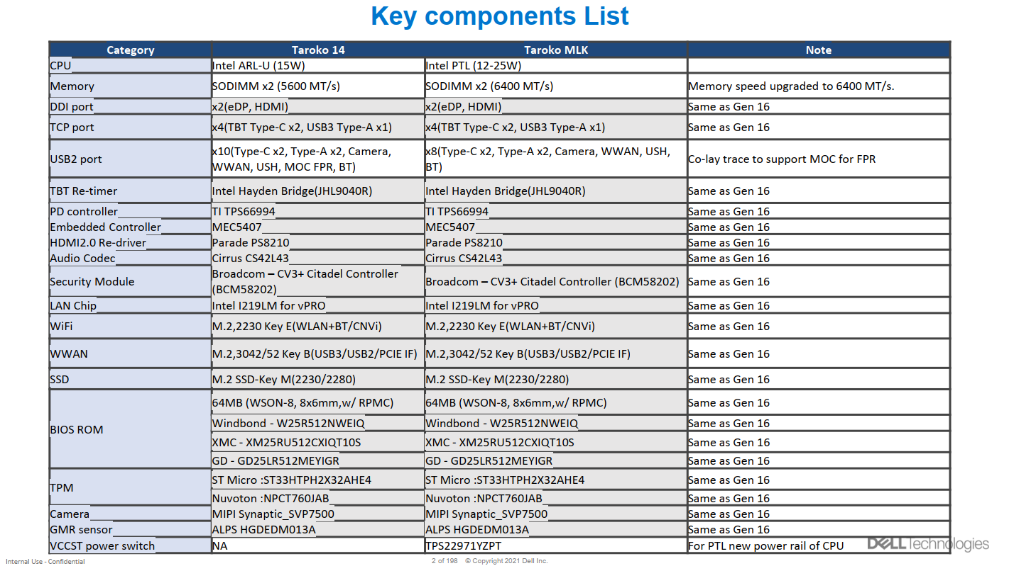
Dell Taroko PTL BOM Example
>87% PTL Taroko key components are reused Gen16 ARL-U Taroko design

Slide 16
Backup – OEM alignment deck

Slide 17
PTL-H 12Xe Design Optimization
For Use Under CNDA:8166202 Dell
WW43

Slide 18
Legal Disclaimer
You may not use or facilitate the use of this document in connection with any infringement or other legal analysis. You may not use or facilitate the use of this document in connection with any infringement or other legal analysis concerning Intel products described herein. You agree to grant Intel a non-exclusive, royalty-free license to any patent claim thereafter drafted which includes subject matter disclosed herein.
No license (express or implied, by estoppel or otherwise) to any intellectual property rights is granted by this document.
All information provided here is subject to change without notice. Contact your Intel representative to obtain the latest Intel product specifications and roadmaps.
All product plans and roadmaps are subject to change without notice.
The products described may contain design defects or errors known as errata, which may cause the product to deviate from published specifications. Current characterized errata are available on request.
Intel technologies’ features and benefits depend on system configuration and may require enabled hardware, software or service activation. Performance varies depending on system configuration. No computer system can be absolutely secure. Check with your system manufacturer or retailer or learn more at intel.com.
Intel disclaims all express and implied warranties, including without limitation, the implied warranties of merchantability, fitness for a particular purpose, and non-infringement, as well as any warranty arising from course of performance, course of dealing, or usage in trade.
© Intel Corporation​. Intel, the Intel logo, and other Intel marks are trademarks of Intel Corporation or its subsidiaries.
*Other names and brands may be claimed as the property of others.
Copyright© 2024, Intel Corporation. All rights reserved.

Slide 19
PTL EE Design Requests to deliver best quality, performance and battery life, fast TTM
Common core BOM to closely match RVP/AEP for system validation quality and lower design risk. lowest power BOM/component for best battery life
Hetero IMVP PD solution (option#2) for best battery life
iPCM or Intel Power Meter during development phase for efficient power telemetry, validation and debug
PCB stack-up follow PDG/BEP to ensure memory board quality to meet POR memory speed, LPDDR5 memory layout (break-in, break-out) should follow memory clip file (818137) for memory design quality, require ODM to run iPDS, iCCT to ensure crosstalk quality
Decoupling cap selection and placement follow acoustic noise mitigation TA (#575216) to have good hardware design practices to avoid acoustic noise.
keep SFF connector for issue debug efficiency till production. keep iDV connector for power sequencing, PO debug use in EVT.
Intel team will work with Dell/ODM on each of the design requirement assessment

Slide 20
Agenda
RVP/AEP/BEP Key Component & BOM Sharing
Hetero IMVP PD design for best battery life
Best Memory Design Quality through PCB stack-up and memory clip file
System Meter Introduction
For Use Under CNDA:8166202 Dell

Slide 21
PTL RVP/BEP/AEP Key Component List
 | RVP, BEP, AEP | AEP/ BEP
SOC | Replaceable | PTL - H 12Xe/ Replaceable
DRAM | LPCAMM(LP5x), MD(LP5x), SODIMM(DDR5) | MT62F2G32D2DS-020 WT:F / LPCAMM2
VR Controller | Richtek RT3645BEN-01A | MPS MP29011GQKT-0011
EC | Microchip MEC1723 eSPI (RVP, AEP) | MEC1723/ IT82002
LAN IC | Jacksonville | NA
WLAN/BT | Whalepeak-2 (2x2) | Whalepeak-2 1216/ Whalepeak-2 M.2
Audio Codec | Realtek ALC712-VB, ALC1320 , ALC722(RVP) Cirrus Logic CS35L56(AEP) Cirrus Logic CS42L43(BEP MIPI/I2S) | Cirrus Logic CS42L43
Audio Amplify | N/A , within codec (RVP CLASS_D_AMP,NA,CS35L63 (BEP) | CS35L56/ CS35L63
BIOS Flash | Macronix 64MB | GD25LR512ME
Discrete GFX | N/A | Gen5x8 Signals Break - Out done
DDS Switch | N/A
HDMI Pcon | N/A
DP Redriver / Retimer | no DP redriver/retimer PS8419(retimer , for HDMI), PS8219(redriver, for HDMI) | PI3HDX12211ZHEX (Redriver HDMI)
PCIE Redriver / Retimer | N/A
Discrete TBT | Barlow Ridge
TBT Retimer | HBR , GBR | HBR / GBR
PD Controller | CYPD6229 ; TPS66994; RTS5453P-28 | TPS66994
USB3.2 Gen2 Retimer | Doides PI3EQX1004E2ZTFEX (BEP) | NA
USB3 Retimer / Redriver | N/A | PI3EQX1004E2ZTFEX
USB2 Redriver | TUSB212IRWBR(BEP reserved)
Discrete TPM | Infineon SLB9672VQ 2.0 (RVP, AEP, BEP) Nations Tech Z32H330TC(RVP) | SLB9672VQ 2.0
Card Reader IC | BayHub BH770GG7(AEP) | BH770GG7LN-A-0
eDP Panel
PCB | T3 or T4, 6L or 8L or 10 L | T4 - 10L/ T3 8L
Storage | Gen4 NVMe WD SN810 CS-512GB | Gen5x4 - 512GB
Charger | RAA489110ARGNP(RVP, AEP) SC8885SQDER(BEP) | RAA489110ARGNP/ SC8885SQDER
For Use Under CNDA:8166202 Dell

Slide 22
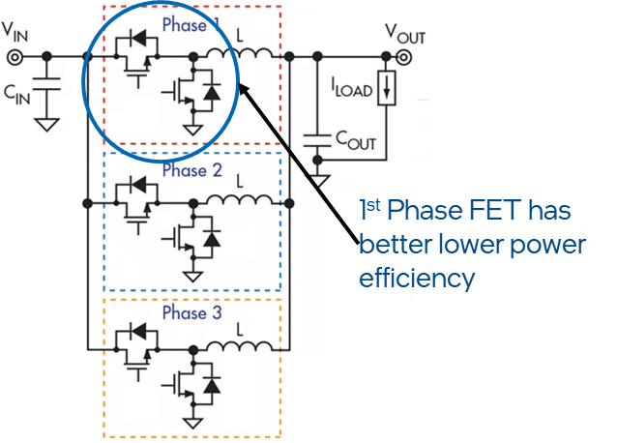
Hetero IMVP PD for Best Battery Life
First Phase Efficiency Improvement
Vendor Support
Support | MPS | AOS | Renesas | Richtek
Lower PS1 Frequency | IMVP9.2 - √ IMVP9.3 - √ | IMVP9.3 - √ | IMVP9.3 - √ | IMVP9.3 - √
Lower PS2 (DCM) frequencies | IMVP9.2 - √ IMVP9.3 - √ | IMVP9.3 - √ | IMVP9.3 - √ | IMVP9.3 - √
Power Stage selections | IMVP9.2 - √ IMVP9.3 - √ | IMVP9.2 - √ IMVP9.3 - √ | ES1 Q1’ 2025 | IMVP9.2 - √ IMVP9.3 - √
Larger 1st phase Inductance | IMVP9.2 - √ IMVP9.3 - √ | IMVP9.2 - √ IMVP9.3 - √ | IMVP9.3 - √ | IMVP9.2 - √ IMVP9.3 - √
Asymmetric cut offs | IMVP9.2 - √ IMVP9.3 - √ | IMVP9.3 - √ | IMVP9.3 - √ | IMVP9.3 - √
Rail specific Switching Frequency Lower freq -> larger inductance larger L package higher capacitance | Yes | Yes | Yes | Yes
Discrete “baby” phase | MP87435 | 3x3mm FET AOZ51060 | SPS Baby* Phase with Oriole | No
Integrated Baby phase | No | No | Proposal - XPMIC | No
For Use Under CNDA:8166202 Dell
Description
Asymmetric 1st phase –
lower PS1 & PS2 frequency (Extended DCM for improved light load efficiencies)
Light load efficient SPS /DrMOS /FET
larger value inductor
821090Heterogenous Power Delivery Technical Advisory

Slide 23
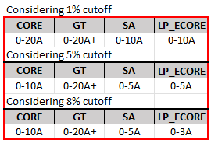
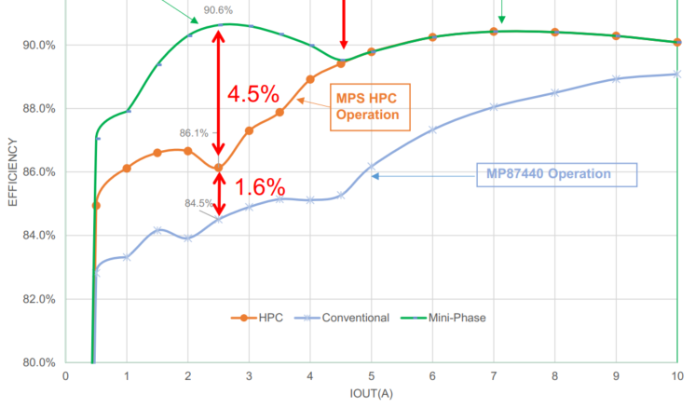
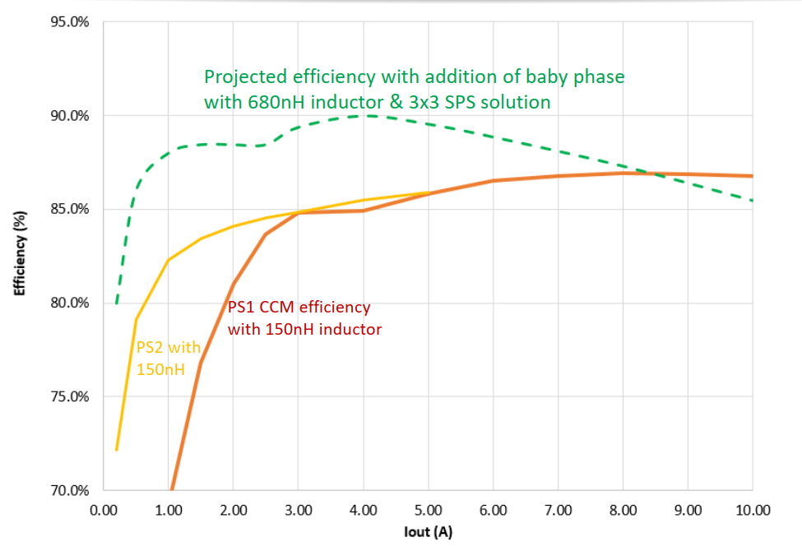
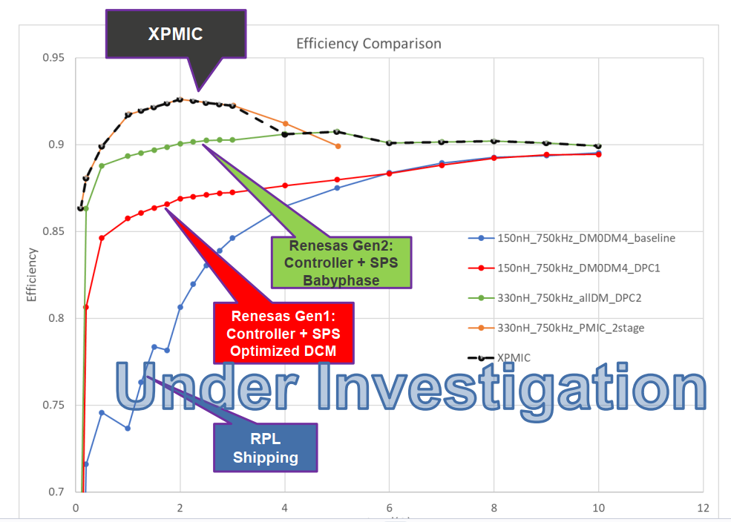
Advanced Optimization For Higher Efficiency
Current residency analysis (PTL projections*)
BOM & real-estate impact
(rough estimate)
*Data for Idle Display ON, Netflix (1080p), Teams (3x3), Geekbench 5.4.5, 3D-Mark Wildlife Extreme
Rail | real-estate delta
VCCIA | + ~10mm2
VCCSA | + ~10mm2
VCCLPECORE | + ~10mm2
For Use Under CNDA:8166202 Dell
Optimization range
Projected benefit - MP87435
Projected benefit - AOZ51060
Projected benefit - Renesas
**Proposal – SPS baby phase/ XPMIC
Note: Eff, power consumption, BOM, real-estate may vary per system, vendor and design implementation

Slide 24
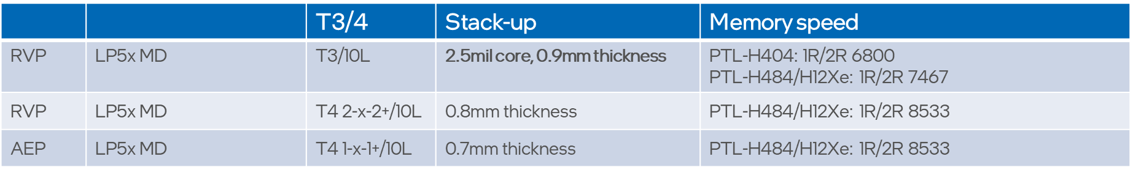
Best Memory Design Quality
Use T3/10L 0.9mm POR stack-up as minimum requirement.
Use memory clip file to ensure memory BO/BI layout quality.
Run IPDS simulation and try to reserved more margin for K indicator.
Run iCCT simulation and ensure XTK results are better than RVP.
For Use Under CNDA:8166202 Dell
Intel Team will work with Dell/ODM at early architecture phase to review PCB stack-up, pre and post layout simulation result to ensure great memory margin and quality

Slide 25
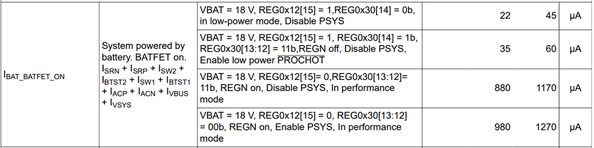
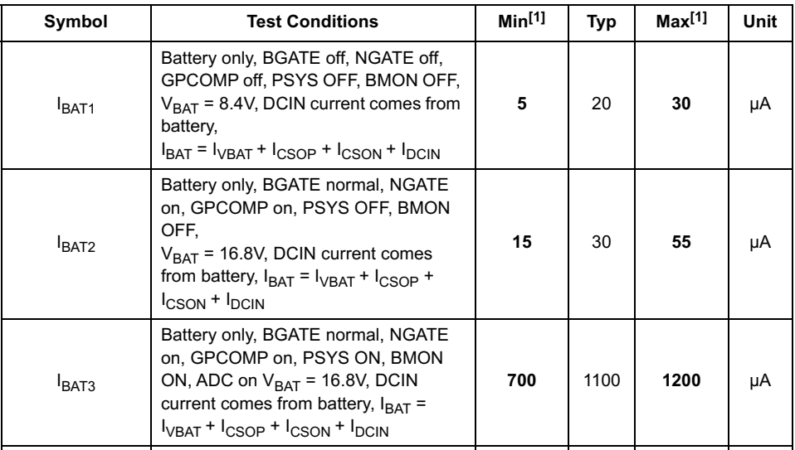
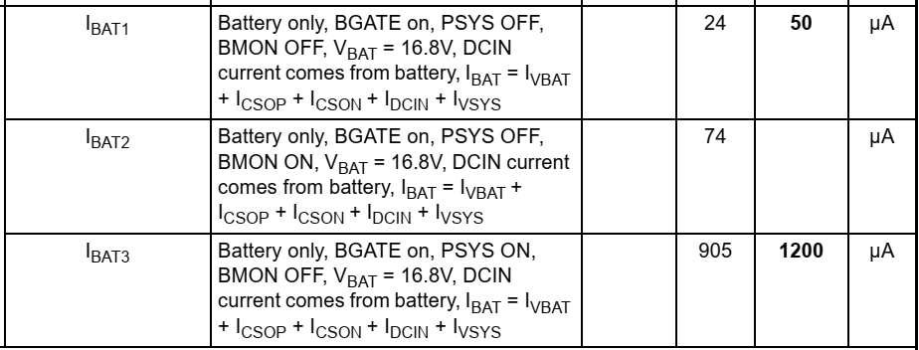
IBAT SPEC for Charger
BQ25728
RAA489110
ISL9538
S5
S0 PSYS EN

Slide 26
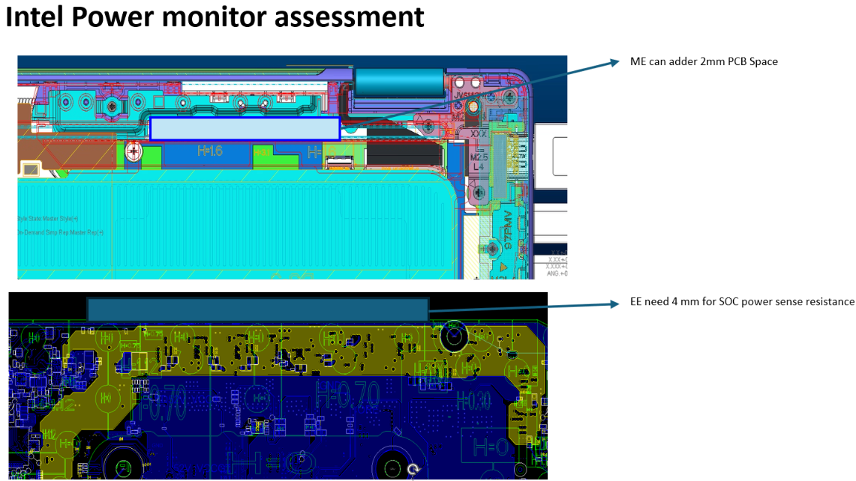
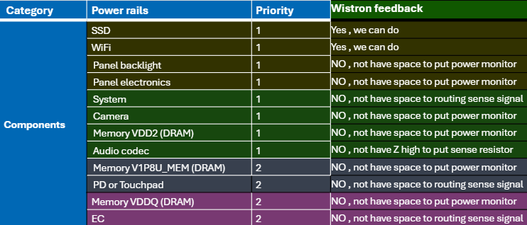
Dell PTL Jarvis System Meter Adoption Challenges
Assessment | Result | Possible Impact of Change
Space for PM components | Only 2 rails(SSD/Wifi) can be monitored due to PCBA space constraint. | N/A
Enlarge PCBA to accommodate components | No. PCBA is already max size in 14” chassis, 16” chassis use same common PCBA as 14” | Chassis change or battery life sacrifices(4mm Y axis PCBA increase) Layout redesign(increase and move PCBA towards south side) PCBA cost

Slide 27
Dell PTL Taorko System Meter Implementation
Component | Function | Power rail | Intel priority | Taroko adoption
PAC1934 | SOC | +VCC_GT | 1 | Y
 |  | +VCC_SA | 1 | Y
 |  | +VCCPRIM_VNNAON | 1 | Y
 |  | +VCC_LP_ECORE | 1 | Y
PAC1934 | SOC | +VCC_CORE | 1 | Y
 |  | +VCCPRIM_IO | 2 | Y
 | Panel | +BL_PWR_SRC | 1 | Y
 |  | +3V_LCDVDD | 1 | Y
PAC1934 | MIPI Camera | +MID_3VS | 1 | Y
 | WLAN | +3V_WLAN | 1 | Y
 | SSD | +3V_SSD | 1 | Y
 | SYSTEM | +BattV_BATT | 1 | Y
PAC1934 | SOC | VDD2(+1.065V_MEM) | 2 | Y
 | SOC/Memory | VDDQ(+0.52V_VDDQ) | 3 | Y
 | EC | +3.3V_ALW_UE1 | 1 | Y
 |  | +1.8V_ALW_UE1 | 1 | Y

Slide 28
Dell Jarvis and Taroko Comparison
 | Taroko | Jarvis
System size (14” or 16”, etc.) |  | 14”/16”
PCB size X * Y (mm) |  | 192.9*110.8
System meter PAC ICs and rails count | 4 PAC ICs 16 rails (8 SOC/memory, 2 panel, 1 camera, 1WLAN, 1 SSD, 2 EC, 1 Batt_in) | 1 PAC IC 2 rails (SSD and Wi-Fi)

